Slide 1

Game Kitchen Presents

Slide 2
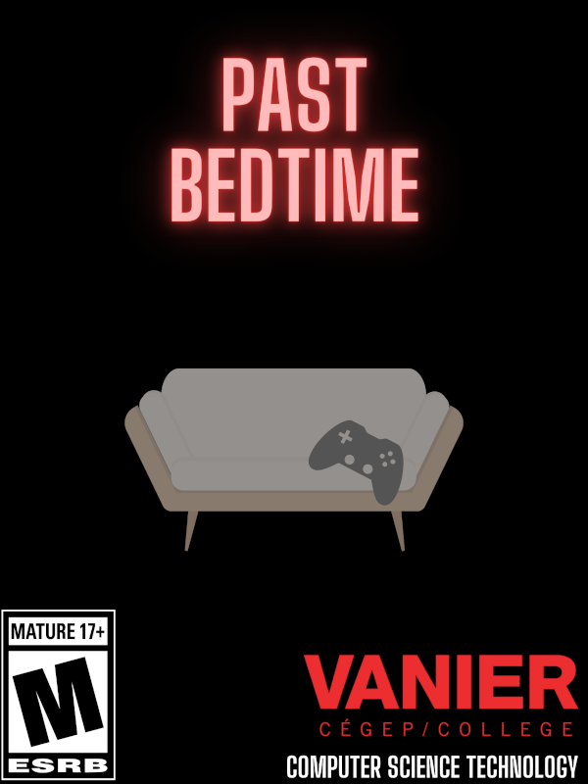
Creators: Nicholas Marijon, Daniel Perrotta and Nicholas Roy
Storyline: A young kid who spends the night playing video games all alone, is set upon by a nasty entity that resembles a virus and would stop at nothing to destroy him in real life.

Slide 3

How To Play The Game
Protagonist’s Perspective
W = up
A = left
S = down
D = right
Shift = run
E = interact
Mouse = shoot
Poncho Gun Slingers
A = left (shared for both so in black)
D = right (shared for both so in black)
Space bar = jump (specific to this game so colored orange)
Mouse (left click) = shoot

Slide 4

Game's Core Mechanics
What makes our game stand out?
Collecting items
Solving basic puzzles
Switching between 2 games
Multiple endings depending on what the player does
Forces the player to pay attention to small details

Slide 5
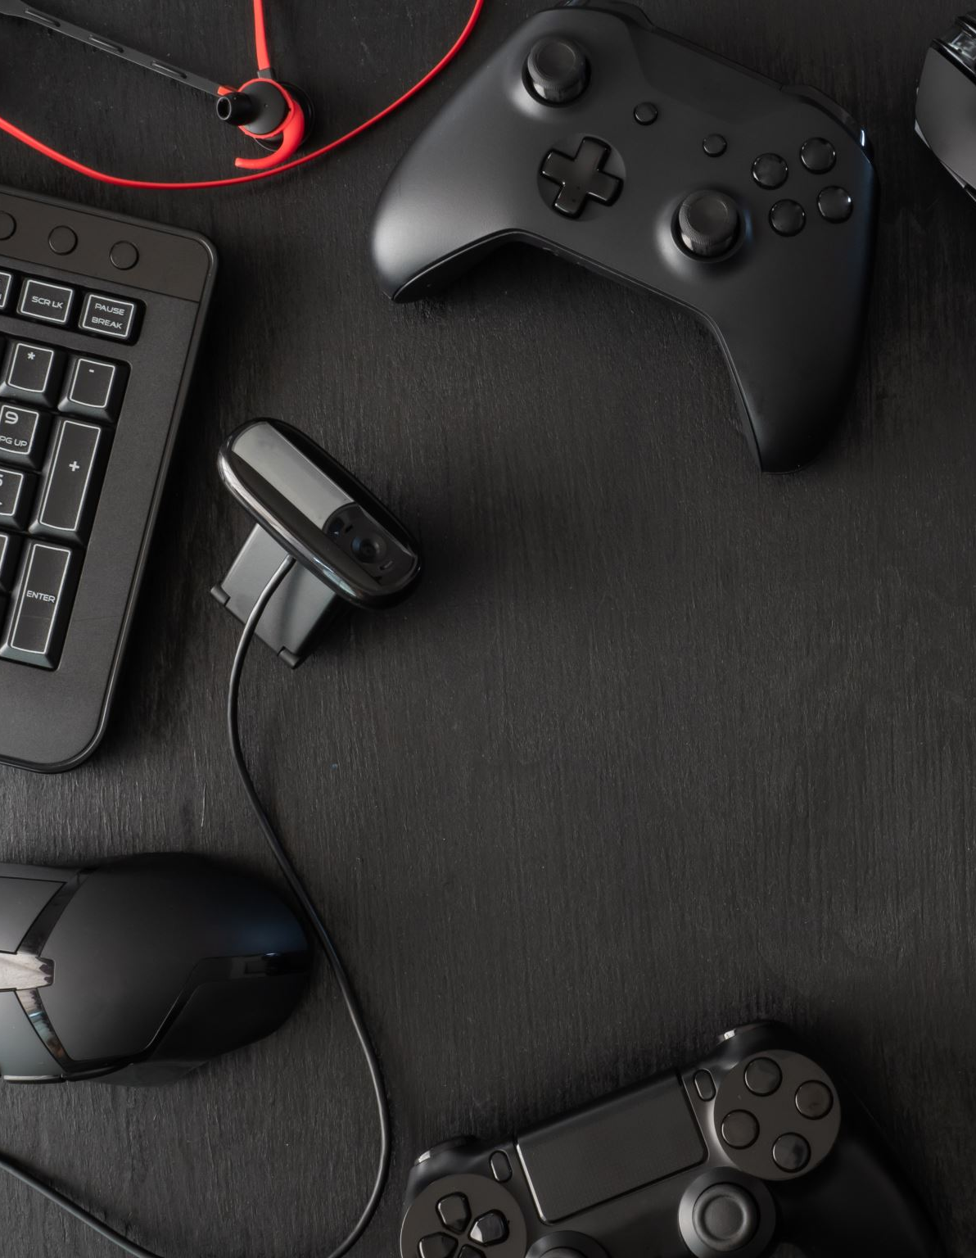
What Makes the Game Interesting
Multiple endings
These add more content
Player interactivity
Feelings of adrenaline to the player
Feeling of unsafety and mystery

Slide 6
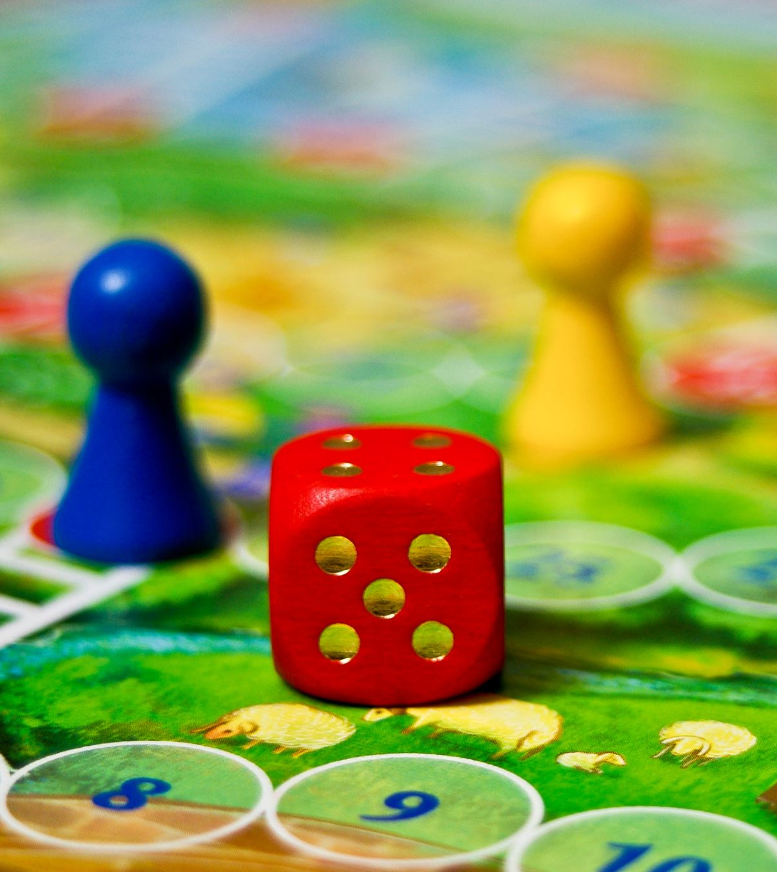
About The Minigame
Why did we add a minigame?
What is its relevance to the game?
What's it called?
What makes it interesting?
What games is this game inspired by?

Slide 7
Future Enhancements
What is next for us at Game Kitchen?
What can we do to make the game better?
Bugs?
More features!
Sequel?

Slide 8

References
Where did we make our art from?
Where did we get our sounds from?
Some sounds were made by us other were off of OpenGameArt.org
Art was made on pixilart.com
Cover screens were made on Canva

Slide 9

Contributions of Team
Nicholas Marijon: Transitions, Start Screens/Ending, Splash Screen, minigame, sounds
Daniel Perrotta: Minigame transitions, art (minigame), company name/cover art, minigame coding, sounds
Nicholas Roy: Art(for main game), coding(main game), sounds

Slide 10
Challenges and Hardships
What obstacles did we face?
What did we sacrifice?
Setting up the minigame
Gravity
Health
Stamina
Github
Sounds

Slide 11

Questions?

